Slide 1
Experiments of Epsilon Dropout
Prepared by Jie Yong Shin
Advisor: Kang Dae-Ki
6th April 2023

Slide 2
Highlights
Epsilon-Dropout: remove high-value nodes at the beginning of the training and remove low-value nodes after several epochs.
Results were mostly worse than without Dropout and with normal Dropout.
There were several things that we must consider deeper.

Slide 3
Outline
Main Idea
Implementation
Experimental Results
Conclusion
Possible Further Works

Slide 4
Outline
Main Idea
Implementation
Experimental Results
Conclusion
Possible Further Works

Slide 5
Main Idea
Drop high-value nodes, then Drop low values (high-drop > low-drop).
Assumption 1) By restricting high values, give more chances for the network to learn more about the details of the data.
Assumption 2) By releasing restriction, learn from both significant parts of the image and the details.
Assumption 3) We classify the image fairly by using this information during the training.

Slide 6
Outline
Main Idea
Implementation
Experimental Results
Conclusion
Possible Further Works

Slide 7
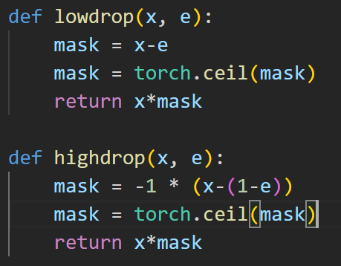


Implementation
Drop high-value nodes, then Drop low-value nodes. (high-drop > low-drop).
Epsilon is a threshold that defines how much will be dropped out.

Slide 8
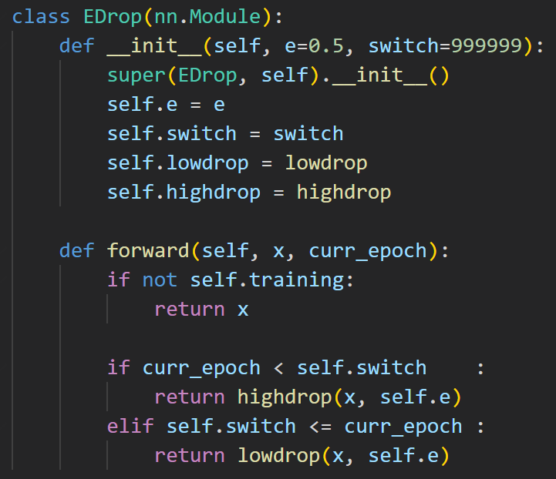


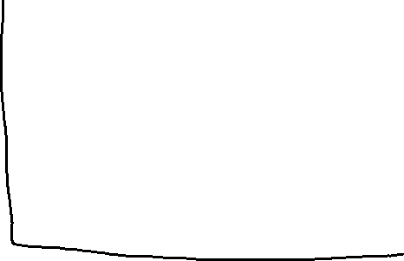
Implementation
Drop high-value nodes, then Drop low-value nodes (high-drop > low-drop).
When to switch will be another hyperparameter named Switch.

Slide 9
Implementation
Input X
Convolution Block #1
Conv
Block
#2
Fully Connected Block
CNN
BN
E-drop block
Max Pooling
FC
BN
E-drop block
FC
Sigmoid
ED
Sigmoid
ED
Output X’

Slide 10
Outline
Main Idea
Implementation
Experimental Results
Conclusion
Possible Further Works

Slide 11
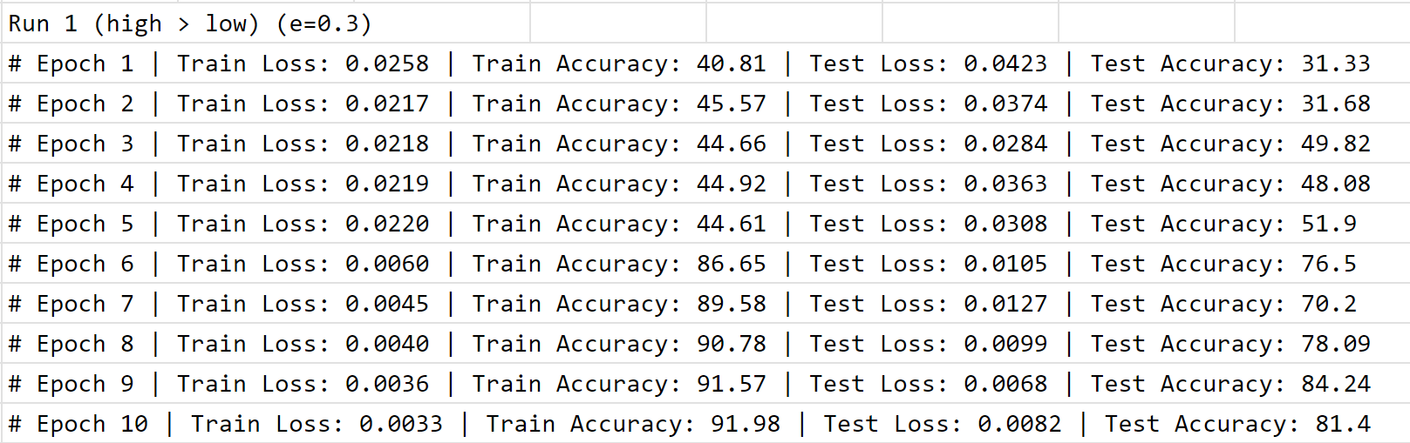
Experimental Results
This experiment has been done on the Fashion_MNIST dataset.
From Epoch 6, the Dropout function changed to High-drop.

Slide 12
Experimental Results
This experiment has been done on the Fashion_MNIST dataset.
From Epoch 6, the Dropout function changed to High-drop.
We have changed the order to (Low > High).

Slide 13
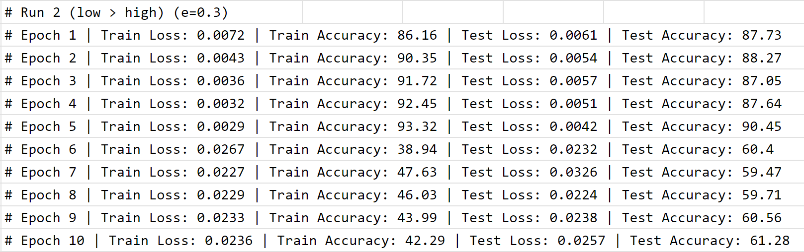
Experimental Results
From Epoch 6, the Dropout function changed to Low-drop.
Result was worse when High-drop was on the run.

Slide 14
Experimental Results
From Epoch 6, the Dropout function changed to Low-drop.
Result was worse when High-drop was on the run.
We have tried with a bigger number of epochs.

Slide 15
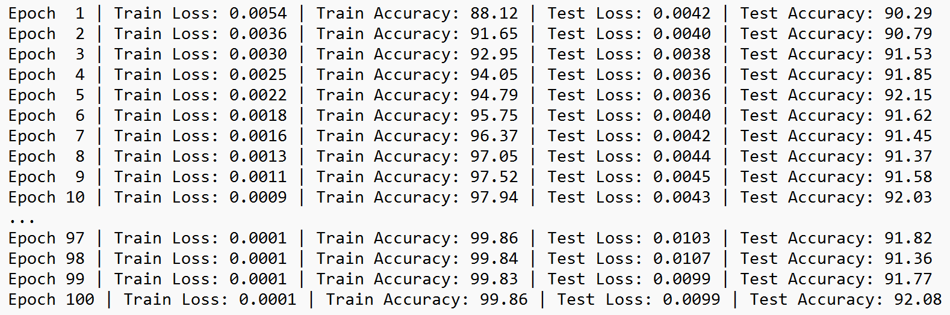
Experimental Results
Baseline for Fashion_MNIST dataset.
Trained with same architecture but without Dropout.

Slide 16
Experimental Results
Baseline for Fashion_MNIST dataset.
Trained with the same architecture but without Dropouts.

Slide 17
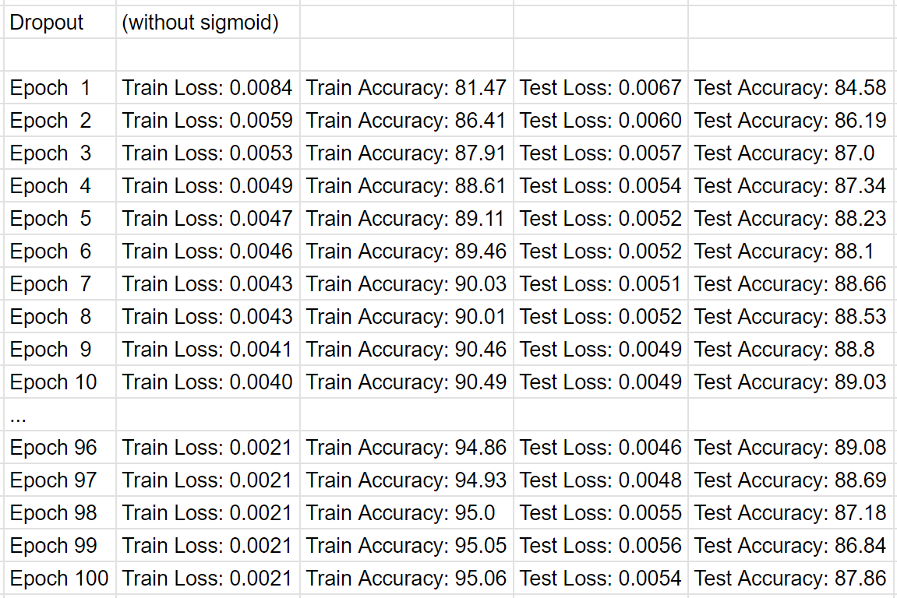
Experimental Results
Baseline for Fashion_MNIST dataset.
Trained with the same architecture but with normal Dropout, with sigmoid function.

Slide 18
Experimental Results
Baseline for Fashion_MNIST dataset.
Trained with the same architecture but with normal Dropout, without sigmoid function.

Slide 19
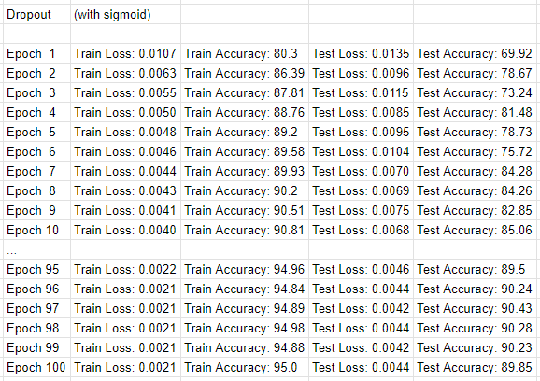
Experimental Results
Baseline for Fashion_MNIST dataset.
Trained with the same architecture but with normal Dropout, with sigmoid function.

Slide 20
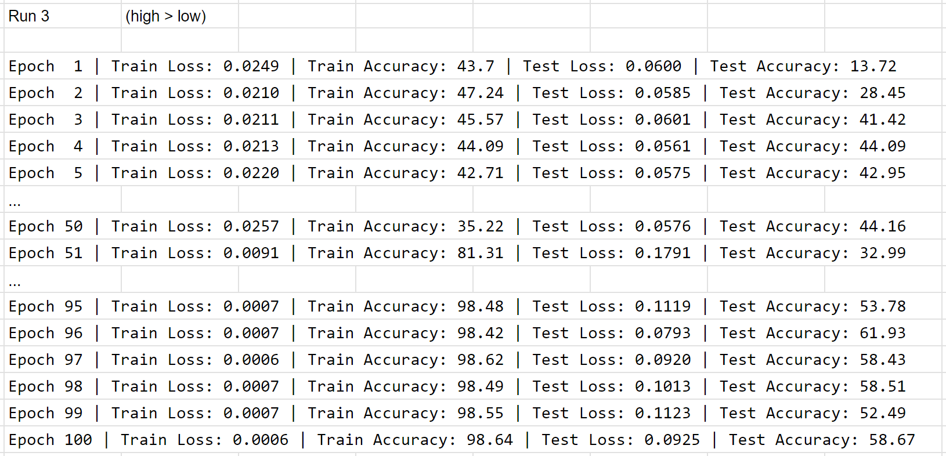
Experimental Results
High-drop to Low-drop at 51st epoch.
Trained with the same architecture but with Epsilon-Dropout.

Slide 21
Experimental Results
High-drop to Low-drop at 51st epoch.
The result seems like the Sigmoid function is removing the effect of Batch-Normalization.

Slide 22
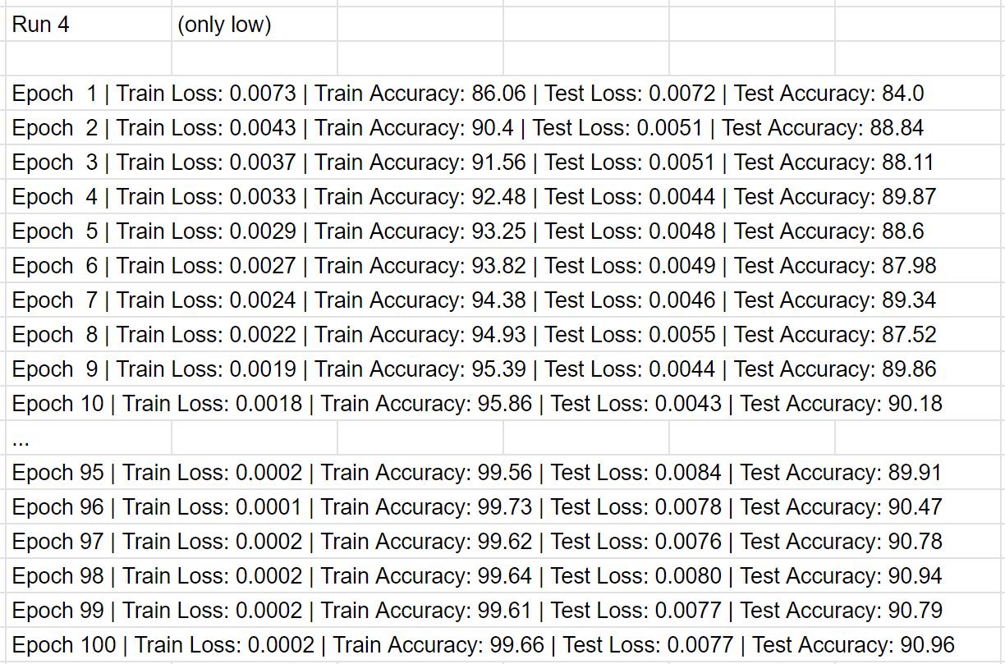
Experimental Results
Trained with only Low-drop.

Slide 23
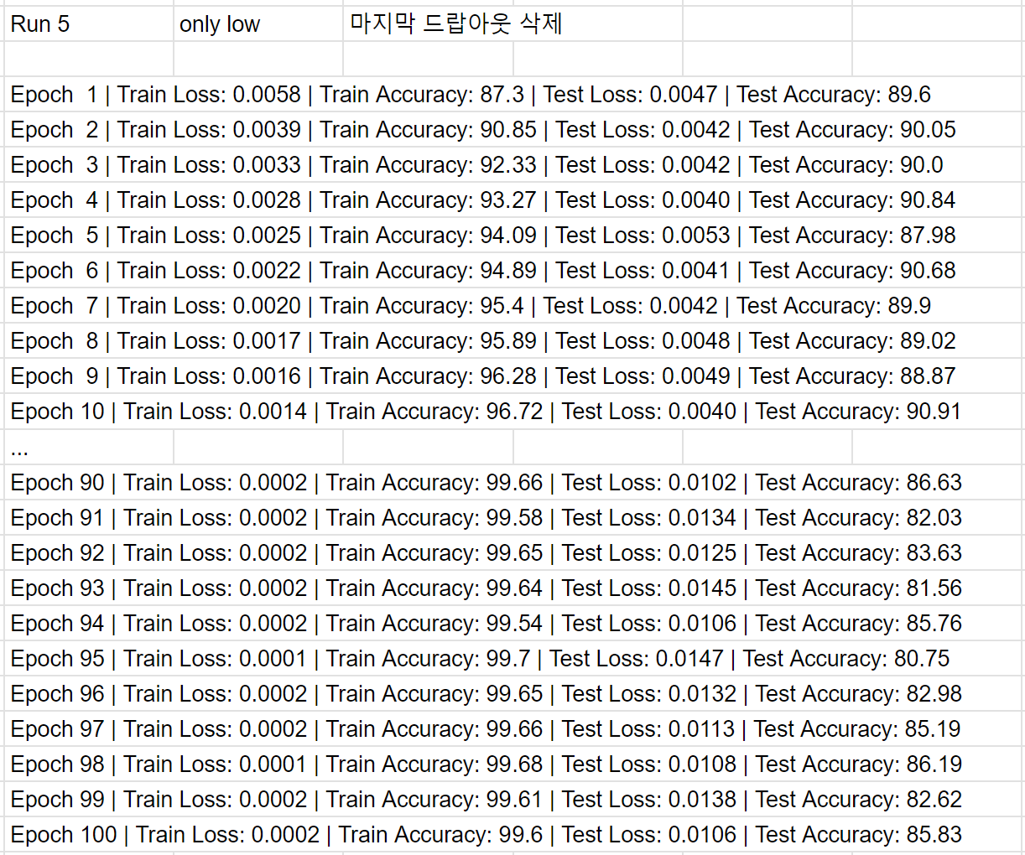
Experimental Results
Trained with only Low-drop and removed last Epsilon-Dropout layer.

Slide 24
Outline
Main Idea
Implementation
Experimental Results
Conclusion
Possible Further Works

Slide 25
Conclusion
We have trained with Fashion_MNIST. As a result, without Dropout had the highest accuracy. This can be because of the dataset. If the dataset is too easy or has enough instances to be trained, the effect of Dropout can be reduced.[1]
Unstable convergence may be due to the use of opposite Dropout Methods.
Max pooling can have a similar effect with High-dropout.[2]

Slide 26
Outline
Main Idea
Implementation
Experimental Results
Conclusion
Possible Further Works

Slide 27
Possible Further Works
Since the Sigmoid seems to have a negative effect, we can think about changing the Sigmoid function to another normalization function.
Since the original idea was learning from both detailed and significant parts of the image, we might need to implement the “High > Low > No Drop” way.
The experimental results from “High > Low > High > Low > High” and “Low > High > Low > High > Low”.
Experiments on other datasets.
We can try with our PC: https://github.com/wldyd920/Epsilon-Dropout

Slide 28
References
“Dropout: A Simple Way to Prevent Neural Networks from Overfitting”, 2014. https://jmlr.org/papers/v15/srivastava14a.html
“MaxDropout: Deep Neural Network Regularization Based on Maximum Output Values”, 2023. https://arxiv.org/abs/2007.13723
The implementation code is uploaded on: https://github.com/wldyd920/Epsilon-Dropout

Slide 29
Thank you!
Q & A

Slide 30
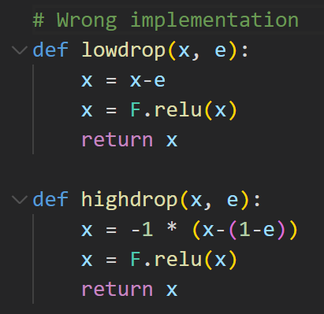
Wrong Implementation
With wrong implementation, Low-drop didn’t had much difference compared to normal Dropout but High-drop had higher accuracy on CIFAR-10 and Fashion_MNIST.

Slide 31





Wrong Implementation
Low-Drop (wrong)

Slide 32


Wrong Implementation
Low-Drop (wrong)

Slide 33


Wrong Implementation
High-Drop (wrong)

Slide 34


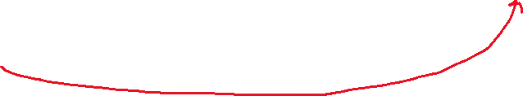
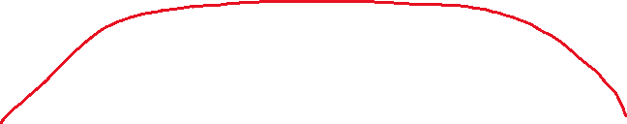
Wrong Implementation
High-Drop (wrong)

Slide 35

Wrong Implementation
High-Drop (wrong)

Slide 36
Wrong Implementation
Epsilon-Drop (wrong) on CIFAR-10 (High > Low)

Slide 37
Wrong Implementation
Epsilon-Drop (wrong) on CIFAR-10
High > Low > High > Low > High
Low > High > Low > High > Low

Slide 38
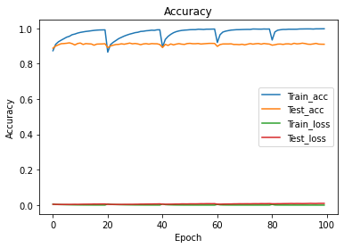
Wrong Implementation
Epsilon-Drop (wrong)
Fashion_MNIST (91.10%)
CIFAR-10 (74.17%)

Slide 39
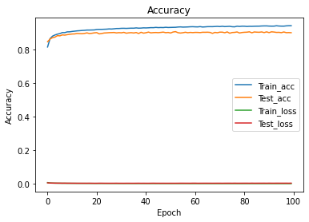
Wrong Implementation
Baseline (with normal Dropout)
Fashion_MNIST (89.97%)
CIFAR-10 (64.64%)

